Slide 1
EraGenus
Age
Gender
An Automated Real time application to predict the key features from human faces.

Slide 2
Technology Used :
Conceive
Develop
Test
Implement
Analyze
Machine Learning
Computer Vision
Process Involved
Web scraping

Slide 3
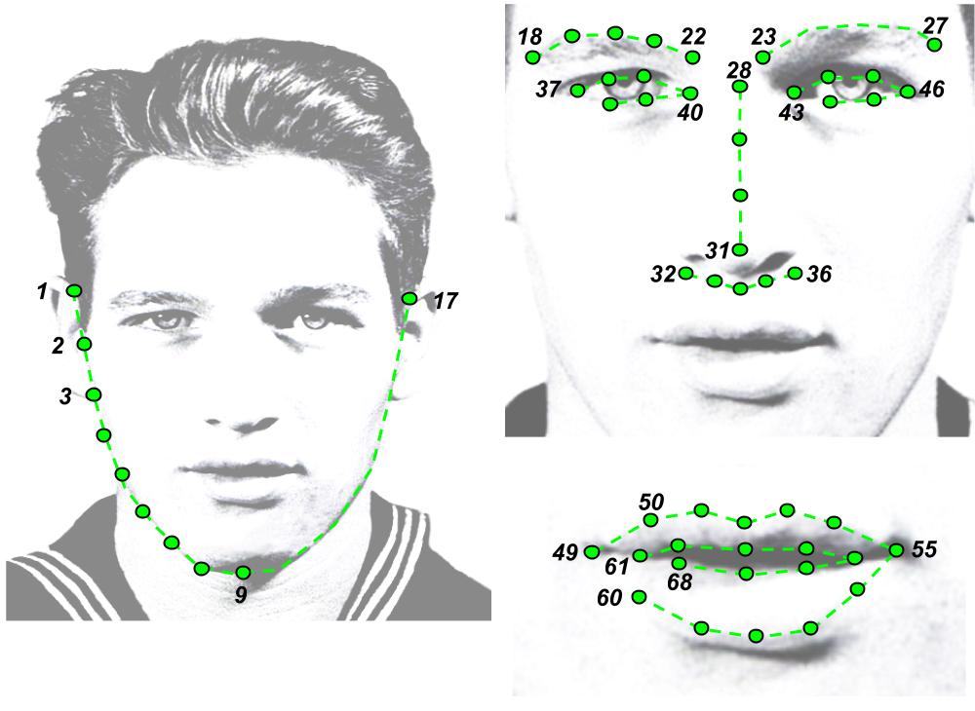
Facial Feature Extraction
Each points
Expressing Key Features

Slide 4
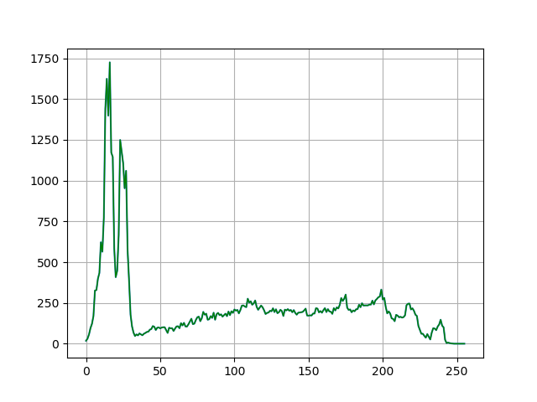
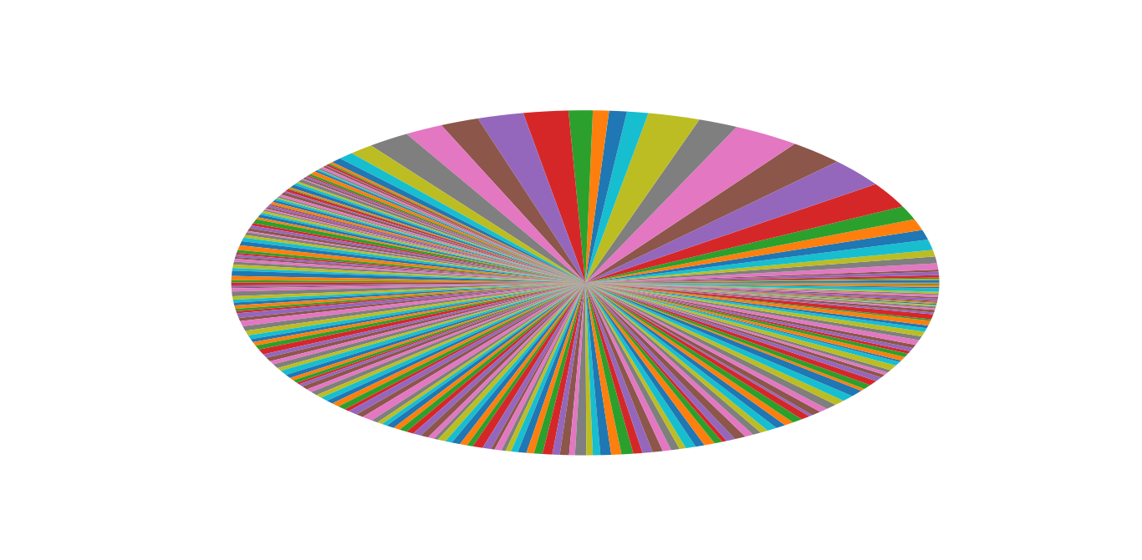
Understanding of data
Region of
Face
Frequency
Region of
Noise
Pixel values

Slide 5
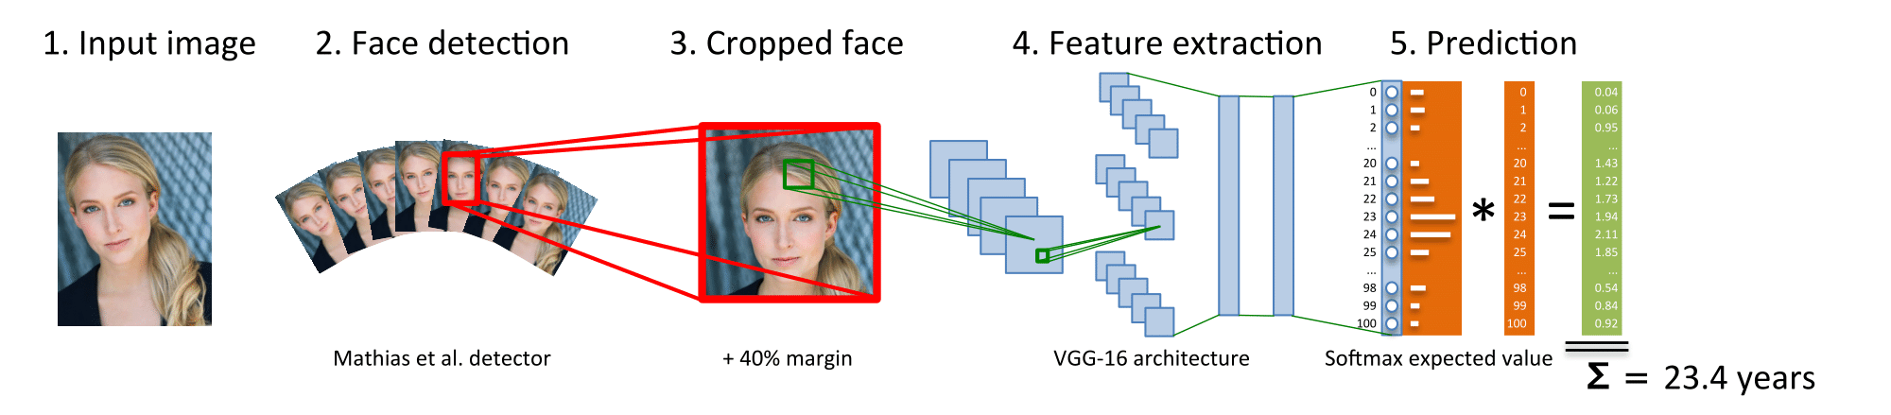
Building a Classifier

Slide 6
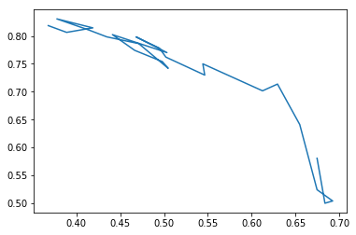
Learning Process
Loss
Accuracy

Slide 7
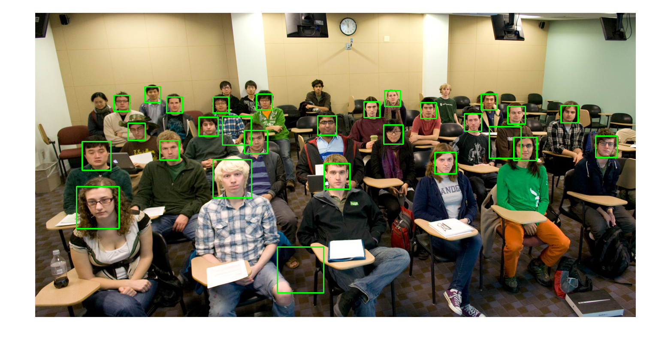
Testing The Application:
Outliers
Eg: Face detection
Accurate

Slide 8

Reason of Variation:
Bad Training.
Image Quality/Webcam Feed .
Poor quality of features selection.

Slide 9
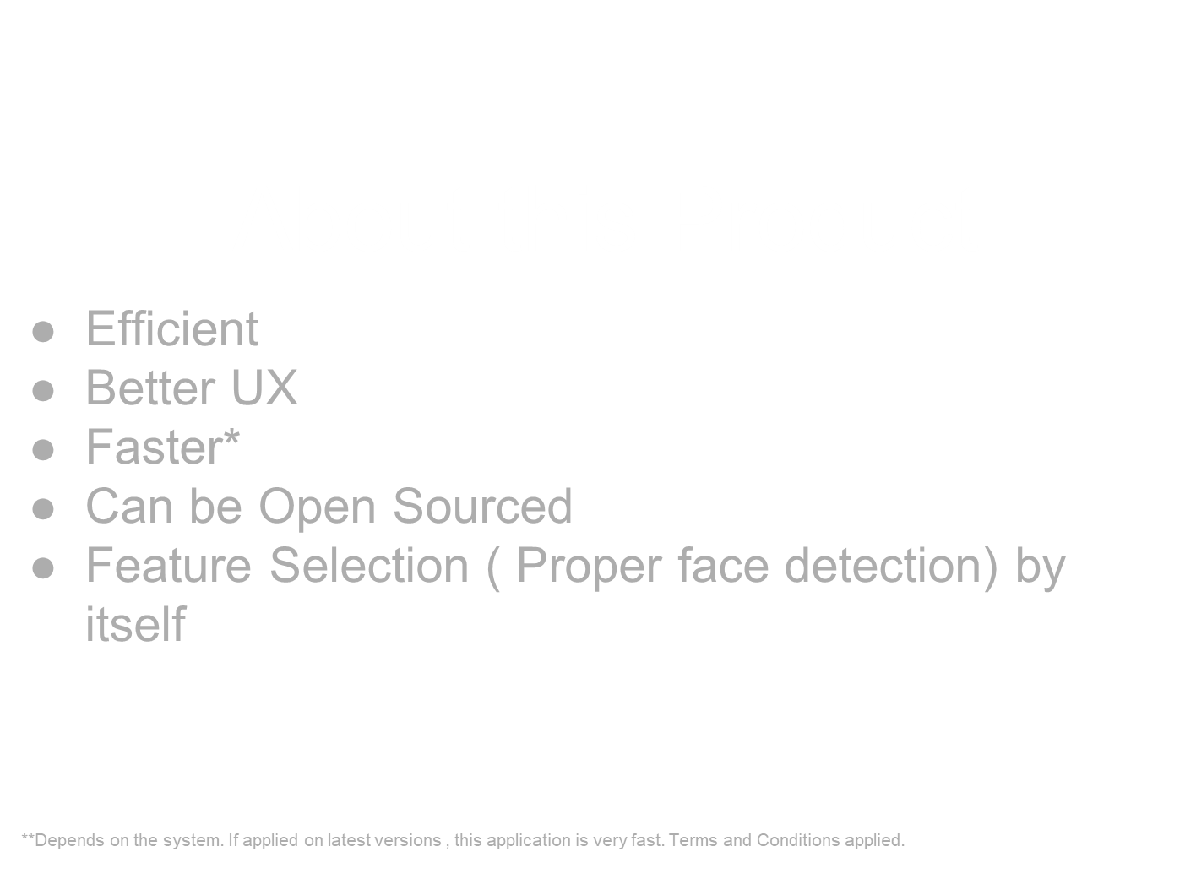

Slide 10
Real World Applications
Accidental Prevention due to drowsiness (Blink Detection).
Real-time Threat Detection.
Emotion Recognition.

